Slide 1
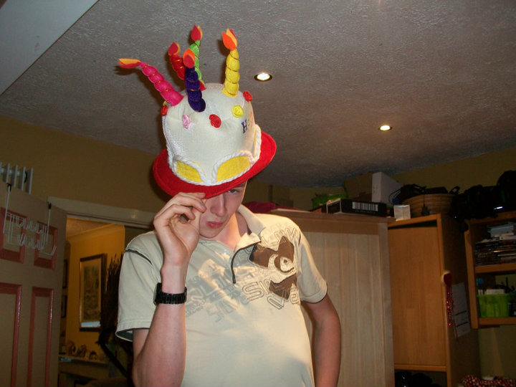
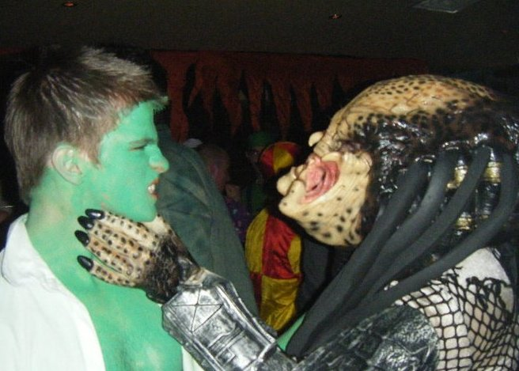
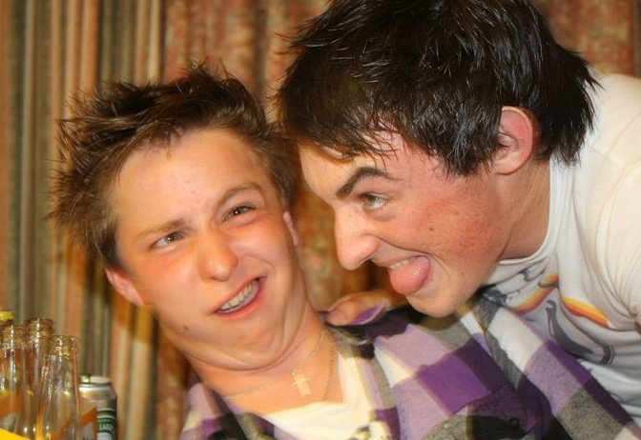
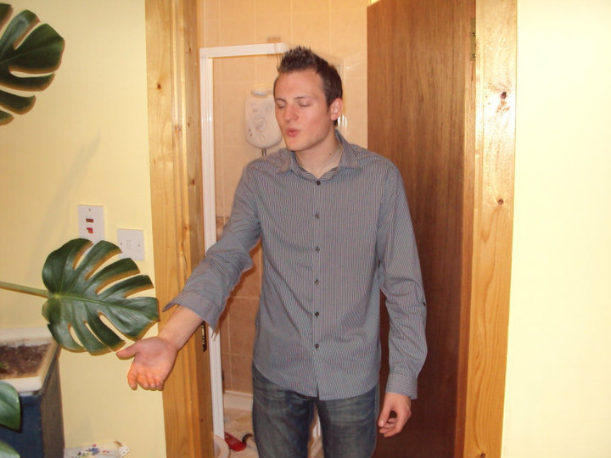
Mark Scanlan
Kevin Roche
Andrew
Hamilton
Kieran Hogan

Slide 2


Slide 3
Why Are We Here?
Engineering
College life

Slide 4
Engineering

Slide 5
Misconceptions
Survey by the Royal Academy of Engineering
General attitude was they “fix things”

Slide 6

What is an Engineer?
Oxford definition
What does this mean?

Slide 7

Problem solving
Ingenuity
Reviewing the options
Weighing up potential benefits and disadvantages

Slide 8
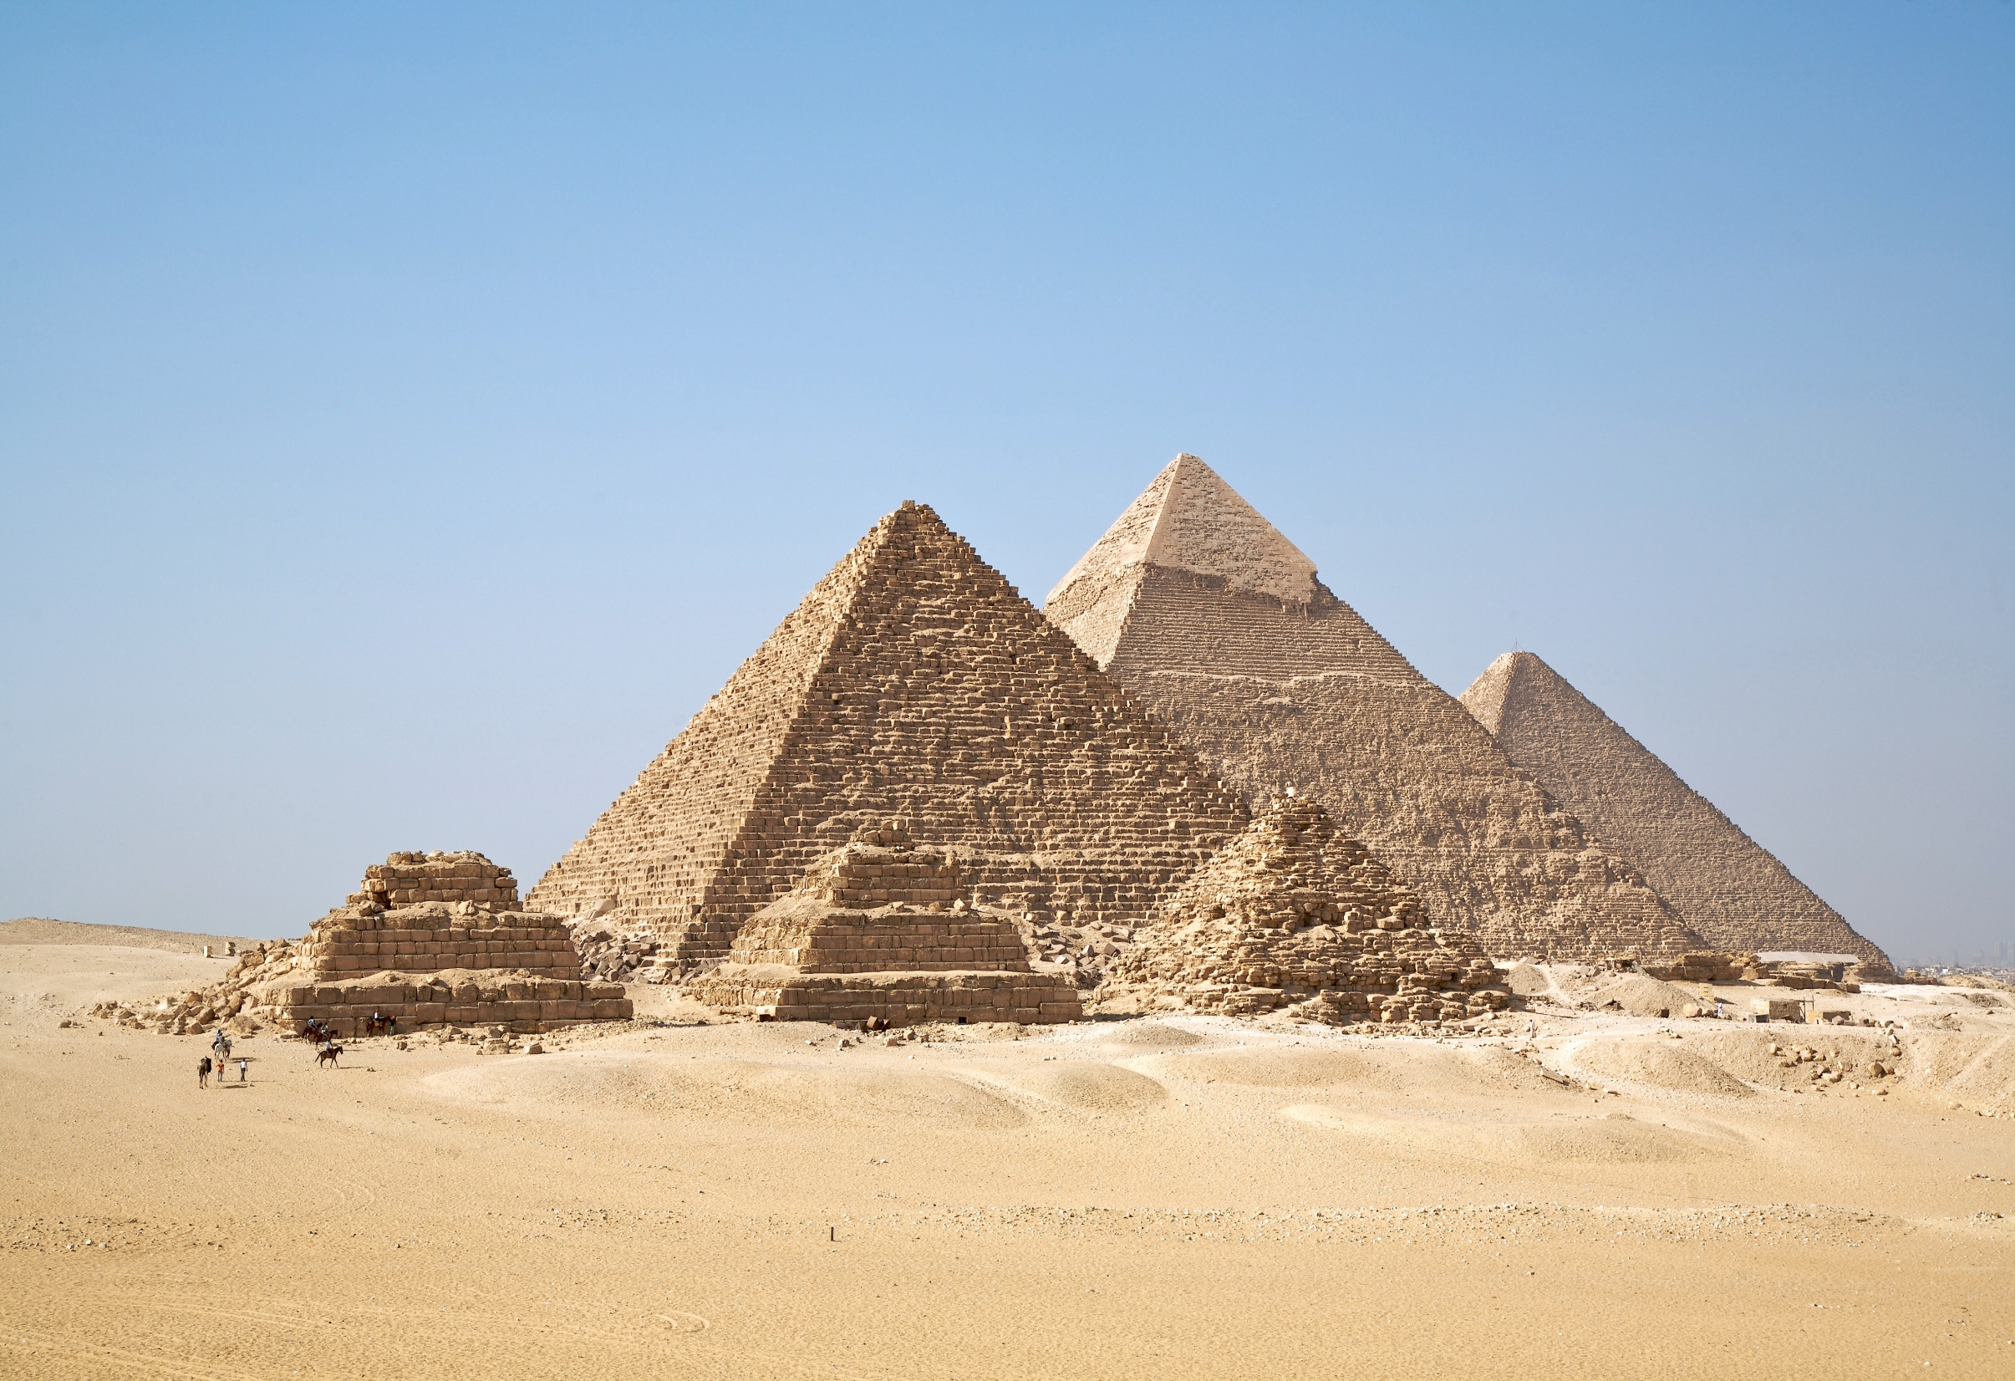

Slide 9
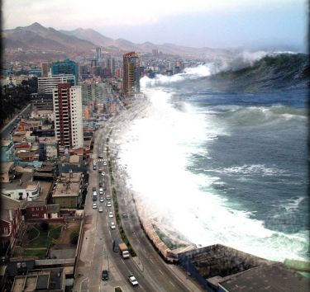
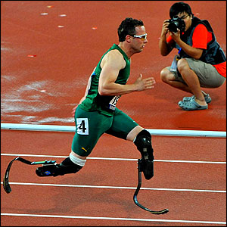

Examples of modern Engineering
Tsunami shelters
Prosthetics
Climate change

Slide 10
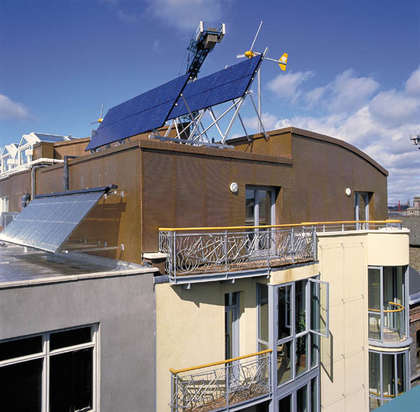
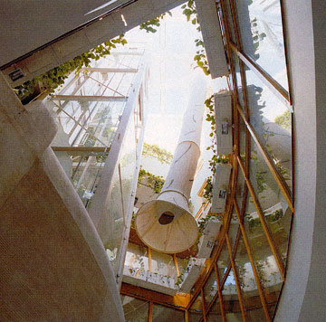
Green Building
Temple Bar

Slide 11

Women in Engineering
In 2001 only 11% of the Engineering workforce were women
Waves

Slide 12
Role Model Day
Presentations by graduates and leading figures
First hand experience
Jacob Engineering, Vodafone, STEPS Engineers Ireland, Irish Industrial Explosives

Slide 13
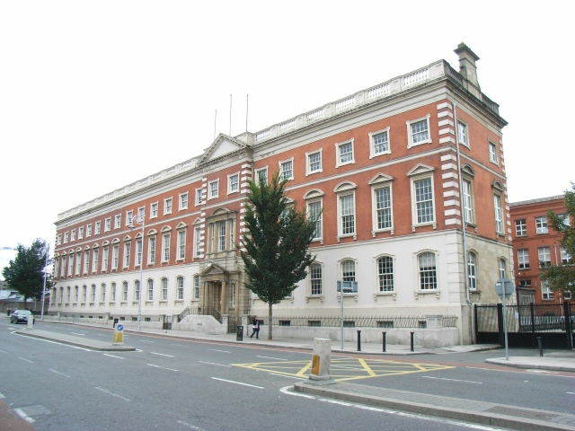
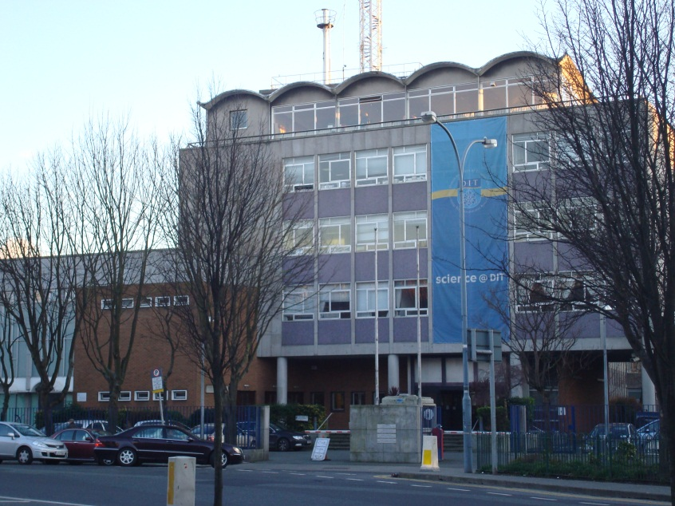
Courses In DIT
DITs Engineering Faculty
Bolton Street
Kevin Street

Slide 14

Undergraduate Programmes
Honours Degree
Ordinary Degree
Higher Certificate

Slide 15

Honours Degrees
Building Services Engineering
Civil Engineering
Computer and Communications Engineering
Electrical / Electronic Engineering

Slide 16

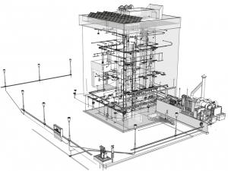
Common
Manufacturing and Design
Mechanical
Structural

Slide 17
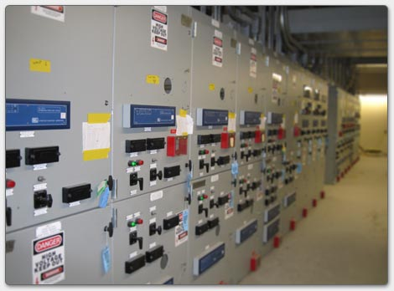
Ordinary Degrees
Automation
Building Services
Civil
Electrical and Control

Slide 18
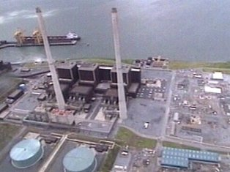
Electrical Services
Mechanical
Electronics and Communications

Slide 19

Higher Certificates
Preliminary Engineering
Level 6 Entrance

Slide 20
Progression
Level 7 -> Level 8
Level 8 -> Level 9 (Masters)
Level 9 -> Level 10 (PHD)
Level 6 (back door route)

Slide 21

Subjects
Mathematics
Physics
Others include Mechanics, Chemistry etc…

Slide 22

Electrical
Services
Engineering
Notes:
Background picture from: www.rovisys.com

Slide 23

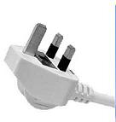
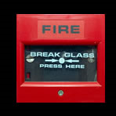
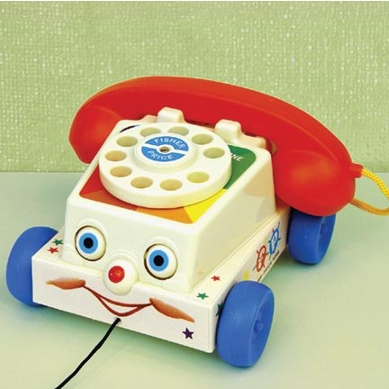
Lighting
General Services
Fire and Safety
Communication
Notes:
Background picture from: www.rovisys.com

Slide 24
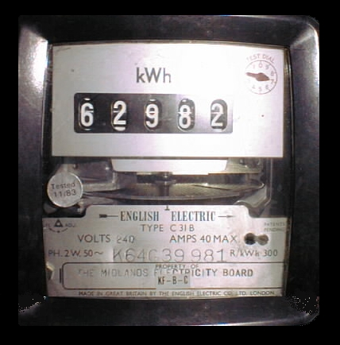
HOW WE CAN ALL SAVE A BIT OF MONEY…
Notes:
Photo by: Unknown

Slide 25

…and the planet...
Notes:
Art by: Unknown

Slide 26

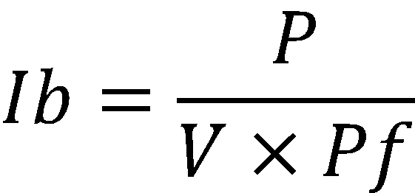
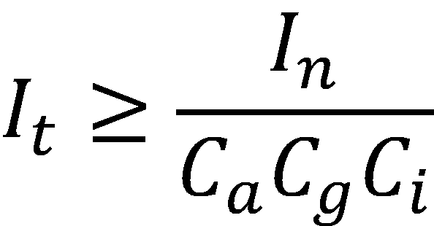
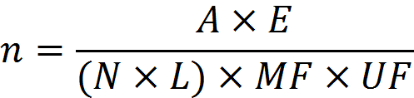
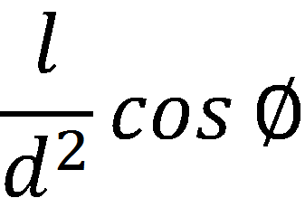


Slide 27
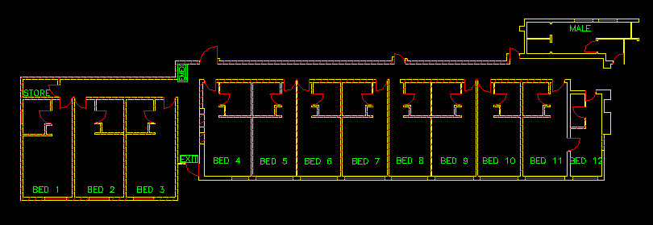
AutoCAD

Slide 28
Our Progression:
Electrical Engineering Level 8
OR
Energy Management Level 8
=> Level 9 => Level 10

Slide 29

D.I.T & College Life
Presented By: Andrew Hamilton

Slide 30
Topics
D.I.T & What it Offers
Daily College life
Clubs and Sports
Societies
Student Discounts

Slide 31

Brief History
Established in 1978
Roots tracing back to 1887
22,000 Full Time Students
1,200 Staff
Awards Bachelor’s, Masters and Doctoral

Slide 32
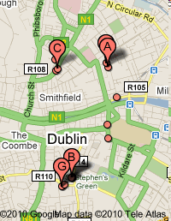
Campus’s
“The City Is Our Campus”
Spread across Dublin City
6 main locations

Slide 33
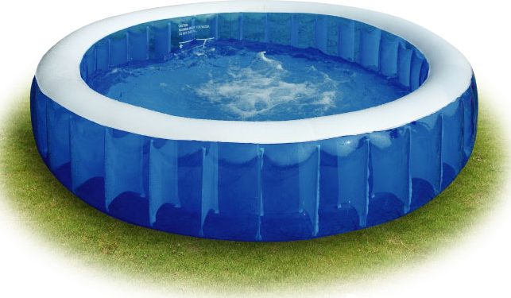
Facilities
Libraries
Gym
Swimming Pool
Climbing Wall

Slide 34

Not All About Education
Making new friends
College activities
Clubs
Societies

Slide 35
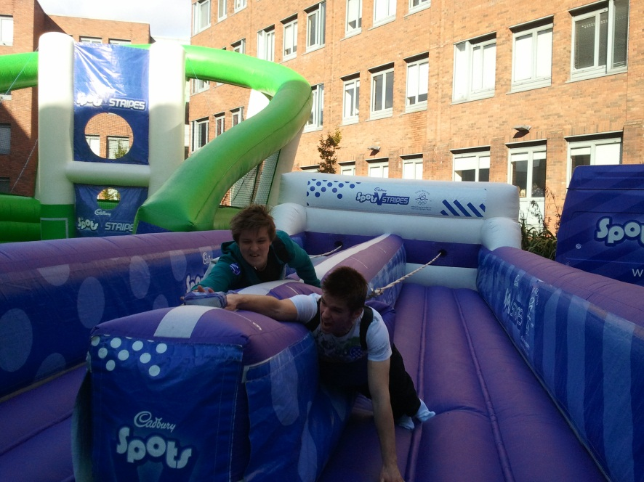
New Friends
Diverse range of people
Working in groups
Learning new skills
Future Colleagues

Slide 36
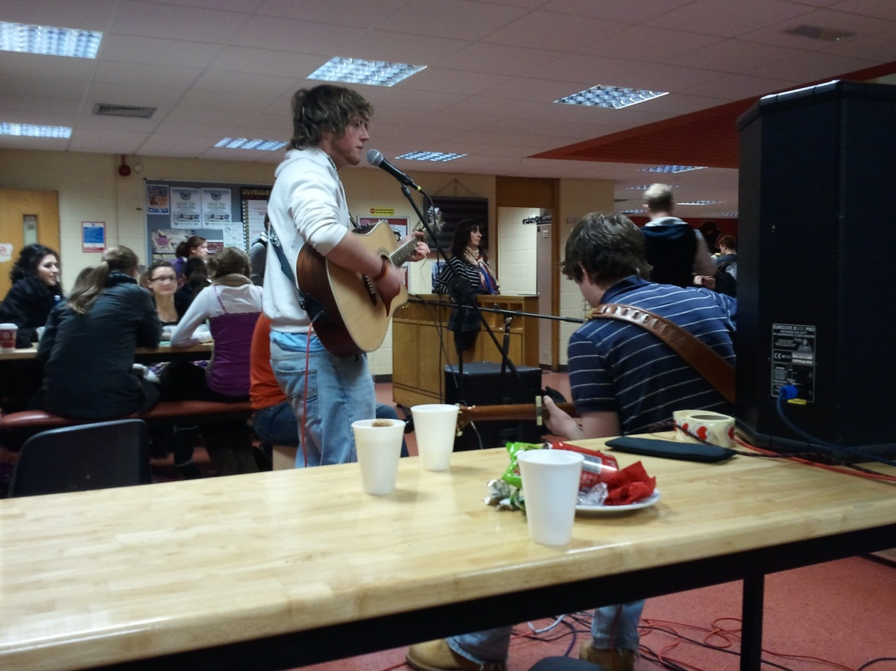
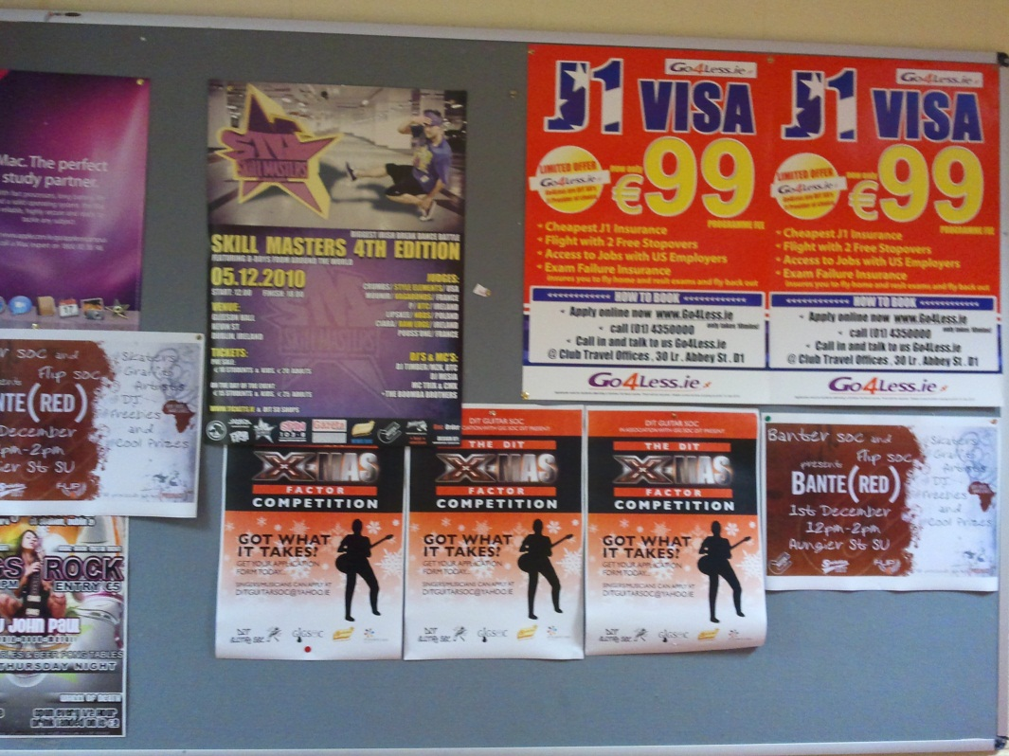
College Activities
Fresher's Ball
RAG week
Promotional events
Bands during lunch
Comedians

Slide 37
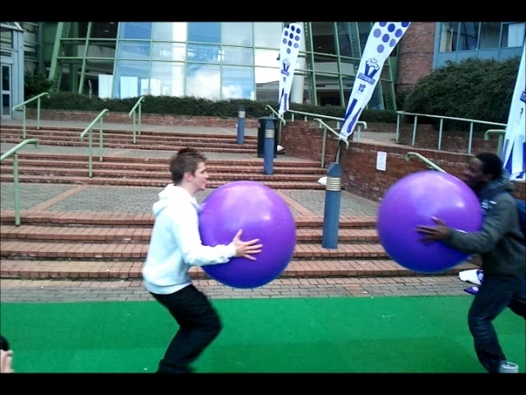

Slide 38
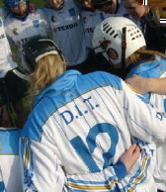
Joining Clubs
Fit 2 Go Club - Cheap membership
Sports Scholarships
Hockey
Rugby
GAA Men/Ladies
Soccer Men/Ladies

Slide 39



Societies
“Get Involved!!”
Over 80 to join
Create your own
Ski soc, DJ soc, Fashion, Poker, Paintball, Karting, Game soc and even a Pirate soc!

Slide 40







Student Discounts!!
10% - 25% off in some shops!
Student Travel Card
Student Nights in Cinemas
Cheap Laptops

Slide 41

Our Experience
CAO / Informed decision
Ability to change
Future plans / options

Slide 42

Information
Open Days (useful to us)
4th December
11th January
Brochures

Slide 43


Conclusion
What is an engineer
Fields Of Engineering
DIT

